Slide 1
EXPOSYS DATALAB INTERNSHIP PROJECT
DIABETES PREDICTION USING MACHINE LEARNING
BY- P S PRITI SUDHA

Slide 2
OVERVIEW
INTRODUCTION
EXISTING METHOD
PROPOSED METHOD
METHODOLOGY
IMPLEMENTATION
RESULT
CONCLUSION

Slide 3
INTRODUCTION
In this Diabetes Prediction using Machine Learning Project Code, the objective is to predict whether the person has diabetes or not based on various features like number of pregnancies, insulin level, age, BMI.
The dataset that has used in this project has taken from the kaggle. “This dataset is originally from the National Institute of Diabetes and Digestive and Kidney Diseases. The objective of the dataset is to diagnostically predict whether or not a patient has diabetes, based on certain diagnostic measurements included in the dataset. Several constraints were placed on the selection of these instances from a larger database. In particular, all patients here are females at least 21 years old of Pima Indian heritage”
I have tried different classifier models and found that support vector machine model gives almost accurate result., means the accuracy score of the SVM model is more as compared to others.

Slide 4
TECHNOLOGIES USED
Python 3.7
Pandas (1.1.5 version)
Numpy (1.19.5 version)
Matplotlib.pyplot
Seaborn (0.11.2 version)

Slide 5
TECHNICAL ASPECT
Training a machine learning model using scikit-learn.
A user has to put details like Number of Pregnancies, Glucose, Insulin level, Age, BMI, etc
Once it gets all the fields information, the prediction is displayed on a predict page.

Slide 6
EXISTING METHOD
The priore diabetes isn’t therefore great than the traditional worth. Diabetes is appreciations to either the exocrine gland not manufacturing plentiful hypoglycemic agent not responding properly to the hypoglycemic agent created.
Various information mining algorithms presents different decision support systems for assisting health specialists. The effectiveness of the decision support system is recognised by its accuracy. Therefore, the objective is to build a decision support system to predict and diagnose a certain disease with extreme amount of precision. The AI consists of ML which is its subfield that resolves the real world difficulties by “providing learning capability to workstation without supplementary program writing”.

Slide 7
PROPOSED METHOD AND ARCHITECTURE
The proposed system focuses using algorithms combinations shown below in the block diagram.
DATA COLLECTION
KNN
Training Dataset
DECISION TREE
RANDOM FOREST CLASSIFIER
PRE PROCESSING
SVM
FEATURE EXTRACTION
LOGISTIC REGRESSION
NAIVE BAYES
Target Dataset
CLASSIFIER
(ML ALGOS)
TEST DATA
MODEL
(PREDICTION SYSTEM)
RESULT ANALYSIS

Slide 8
The base classification algorithms are: Decision tree, Support Vector Machine, Naive Bayes for accuracy.

Slide 9
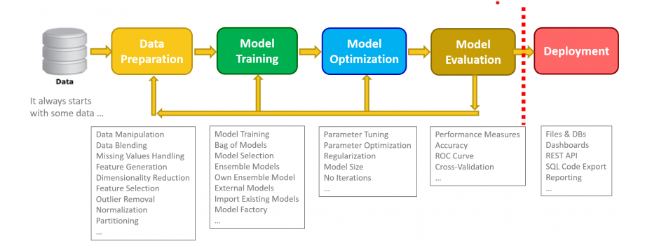
METHODOLOGY
The proposed method use SVM algorithm for classification and prediction of diabetes using trained data.
And the proposed system also predicts the time of getting diabetes.

Slide 10
IMPLEMENTATION
Implementation can be described as the realisation of an application, or execution of the plans, ideas, models, design and system development, specification of the model, standard, algorithms used in the system, or authority.
In computer science, an implement is explained as the realisation of technically specified or algorithm’s as a programmed, a software component, or any others computer systems through computer programming and deployment.
Many of the implementations may existed for a given specification or standard.

Slide 11
START
YES
PROFILE UPDATION
VISITOR
NO
Discussion forum
YES
TRAINING DATASET
About us
LOGIN
NO
Update profile
IS VALID
Contact us
DIABETES PREDICTION
YES
New user
Home page
IS ADMIN
TIME PREDICTION
YES
NO
All member
DISCUSSION FORUM
LOG OUT
END

Slide 12
CONCLUSION
In our project, the result is classified into Yes or No. If the result is classified into No then we use time prediction module. Time prediction i.e. here we predict the “time” of getting the diabetes disease. We analyse the result of the diabetes prediction and check the accuracy of the diabetes prediction, time taken to compute the accuracy of the diabetes prediction, correctly classification and incorrectly classification of result of the diabetes prediction.
We have used SVM algorithm to predict the diabetes where result is classified into Yes or No and also for time prediction module same SVM algorithm is used.
We compared the testing data and actual data to get the accuracy of our project.

